Slide 1
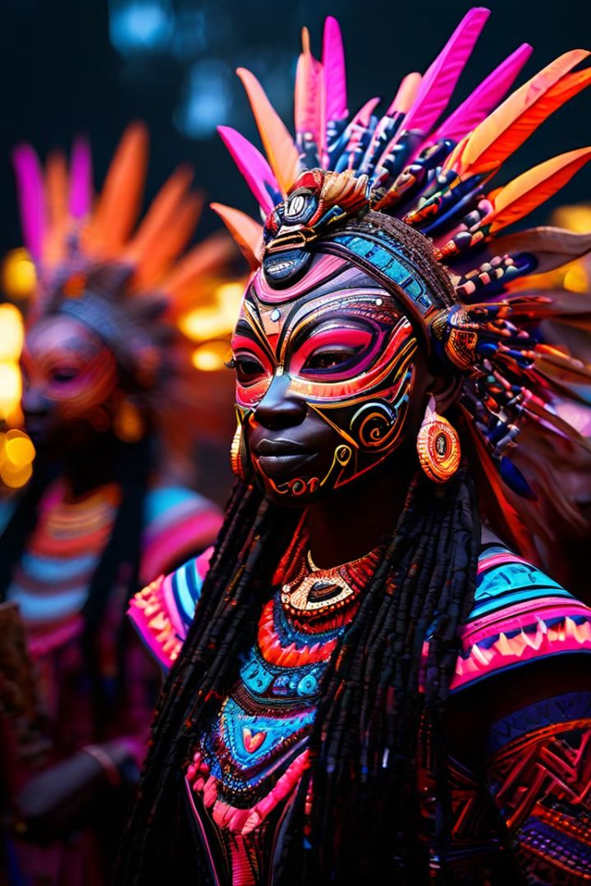

Rites of Passage: Detailed Explanation
Rites of passage are profound cultural ceremonies that mark the transition of an individual from one stage of life to another. These ancient rituals are deeply rooted in many African societies, serving to acknowledge and celebrate key milestones with great significance and reverence.
Samuel maina

Slide 2
Birth Rites
Welcoming Rituals
Fertility Celebrations
Ancestral Connections
Ceremonies to welcome a newborn into the community, often involving blessings, naming, and rituals to protect the child.
Rituals to introduce the child to their ancestors and ensure their protection and guidance throughout life.
Joyous events to honor the mother and celebrate the gift of new life, strengthening bonds within the family.

Slide 3
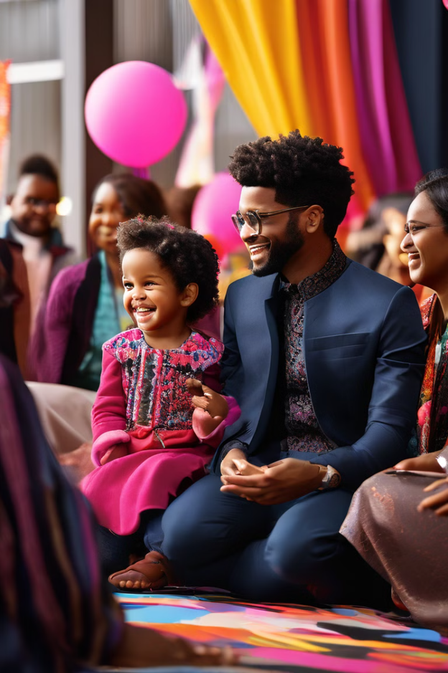

Naming Ceremonies
1
Significance of Names
Names hold deep cultural and spiritual meaning, often reflecting the child's personality, ancestry, or significant events.
2
Ceremonial Blessings
Elders or spiritual leaders bestow the name upon the child through rituals and prayers, invoking protection and guidance.
3
Community Celebration
The naming ceremony is a joyous community event, strengthening the child's connection to their culture and heritage.

Slide 4




Puberty Rites
Marking Maturity
Puberty rites acknowledge the physical and emotional transition from childhood to adulthood.
Teachings and Guidance
Elders impart wisdom, skills, and values to prepare the individual for their new role in the community.
Spiritual Transformation
Rituals and ceremonies facilitate a profound personal and spiritual awakening.

Slide 5
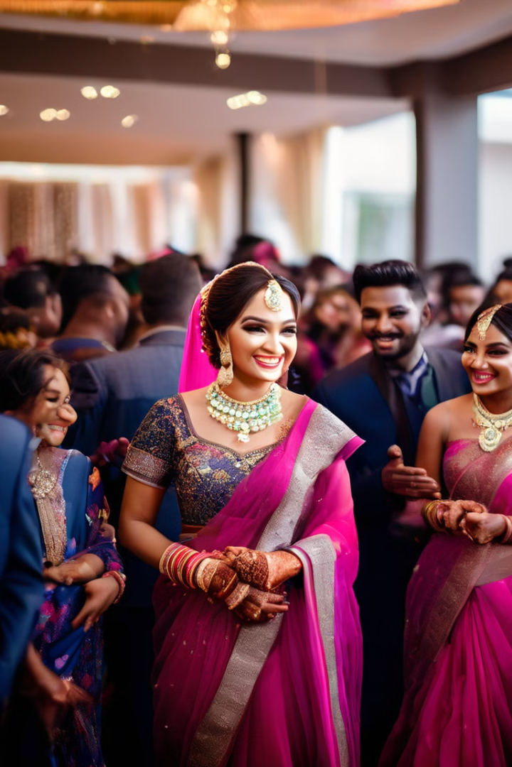
Marriage Rites
Engagement Rituals
Ceremonies to officially announce the engagement and seek the blessings of families and the community.
Wedding Celebrations
Elaborate ceremonies uniting the couple, their families, and the wider community in a joyous celebration.
Marital Bonds
Rituals to strengthen the spiritual and emotional connection between the newlyweds and their families.

Slide 6
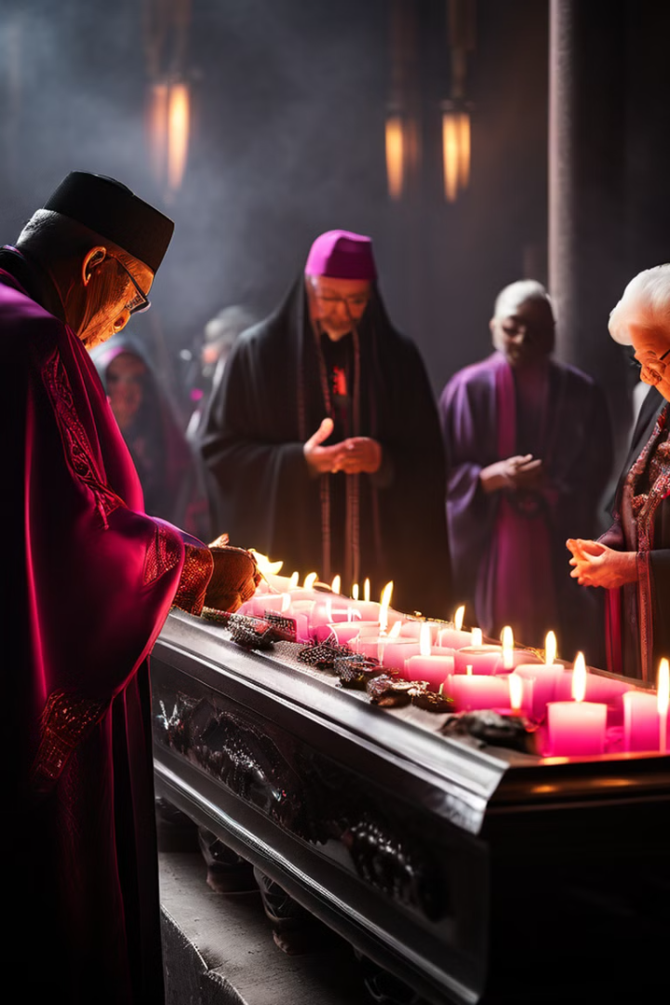
Funeral Rites
1
Mourning
Ceremonies to honor the deceased and provide comfort to the grieving family and community.
2
Burial
Rituals to respectfully lay the deceased to rest, ensuring a peaceful transition to the afterlife.
3
Remembrance
Continued ceremonies and rituals to maintain a connection with the departed and honor their memory.

Slide 7




Initiation Rites
Knowledge Transfer
Elders impart essential cultural knowledge and wisdom to the initiates.
Spiritual Empowerment
Rituals and ceremonies strengthen the initiates' connection to their spiritual heritage.
Community Integration
Successful completion of the rites marks the initiate's acceptance into the adult community.

Slide 8
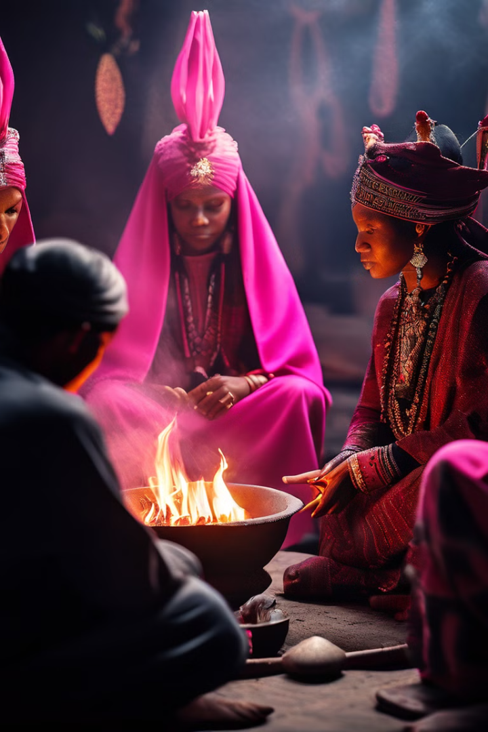
Spiritual Rites
Ancestral Veneration
Rituals to honor and connect with ancestral spirits, seeking their guidance and protection.
Divination Practices
Ceremonies involving the interpretation of signs and omens to uncover the will of the divine.
Cleansing Rituals
Rituals to purify the mind, body, and spirit, removing negative energies and restoring balance.

Slide 9
Cultural Significance of Rites of Passage
Strengthening Identity
Fostering Belonging
Transmitting Traditions
These ceremonies create a sense of shared experience and belonging, uniting the community.
Rites of passage reinforce an individual's connection to their cultural heritage and community.
The rituals serve as a means to pass down cultural knowledge and values to the next generation.

